Slide 1
Characterization and Application of Android WiFi-RTT API
Team Members: Yi Song, Yifan Zhang

Slide 2
Overview
Introduction
Background
Android WiFi RTT API
Hardware and Test Scenarios
Data Analysis
Application
Demo
Q&A

Slide 3

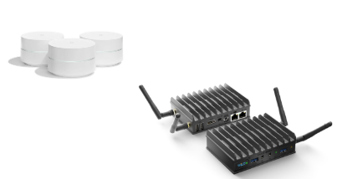
Introduction
Use Google WiFi RTT API and Google AP/WILD AP to :
Goal 1: Characterizing WiFi RTT precision across different platforms and scenarios.
Goal 2: Provide a Proof-of-Concept application for WiFi RTT-based car localization in parking lots
Notes:
Images retrieved from https://www.google.com/url?sa=i&source=images&cd=&ved=2ahUKEwiyt86R8_vgAhXJv54KHUVND1kQjRx6BAgBEAU&url=https%3A%2F%2Fen.wikipedia.org%2Fwiki%2FFile%3AAndroid_robot.svg&psig=AOvVaw1eJKKvz_CJNpfvn3KdB-i9&ust=1552455925782590
https://www.google.com/url?sa=i&source=images&cd=&cad=rja&uact=8&ved=2ahUKEwjemPO0zLrgAhXqwVQKHX7pDuoQjRx6BAgBEAU&url=https%3A%2F%2Fwww.amazon.com%2FGoogle-WiFi-system-3-Pack-replacement%2Fdp%2FB01MAW2294&psig=AOvVaw0bkdGBrVcTOFE71SyjG39n&ust=1550212139821726
https://www.google.com/url?sa=i&source=images&cd=&cad=rja&uact=8&ved=2ahUKEwicy8rUzLrgAhWPAnwKHZPlCvQQjRx6BAgBEAU&url=https%3A%2F%2Fwww.cnx-software.com%2F2018%2F09%2F05%2Fcompulab-wild-wifi-rtt-router-802-11mc%2F&psig=AOvVaw2tHs4RhmySf_-BuB9hbpR6&ust=1550212212399946

Slide 4
Some facts and backgrounds
WiFi Fine Time Measurement (FTM) protocol introduced in IEEE 802.11-2016 (REV 802.11mc)
WiFi FTM protocol is based on time-of-flight
WiFi Certified Location™ was introduced in 2017
Google introduced an Android API that support WiFi Round-Trip-Time(RTT) on I/O 2018
Most initial verification experiments online are based on customized open platform
There are few devices/APs support that protocol, we used Google’s Pixel Phone as devices, Google WiFi and WILD AP as the access points in our project
Mainly Qualcomm and Intel WiFi chips are used in the WiFi FTM supported devices/APs

Slide 5
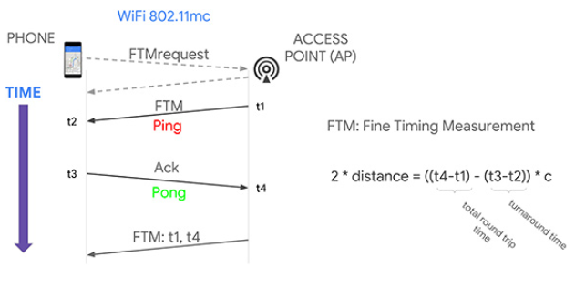
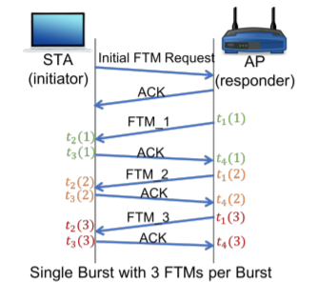
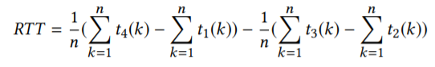
Technical backgrounds - WiFi RTT
Figure retrieved from Frank van Diggelen, Roy Want and Wei Wang
Device not Sync.
STA in ASAP mode
Multiple FTMs per burst
Figure retrieved from M. Ibrahim, et. al, Verification: Accuracy Evaluation of WiFi Fine Time Measurements on an Open Platform
Notes:
Refer to https://www.gpsworld.com/how-to-achieve-1-meter-accuracy-in-android/
1st phone scan for access points, once detected, send FTMrequest to ap and ap should respond allow access

Slide 6
Android RTT API
Procedures:
Search for RTT-capable APs (based on WiFi beacons information elements)
Make FTM requests
Receive of FTM packets and send acknowledgment (upon request approval) (~8 FTMs per burst)
Receive of all the timestamps from AP and calculate distance
Features:
Means and Variances of all FTMs are retrievable
The API is included in the Fused Location Provider for accurate indoor localization in the future
Down to one-meter accuracy

Slide 7
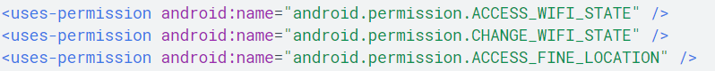
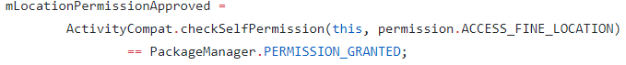
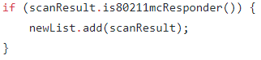
Using the API
Need to declare ACCESS_FINE_LOCATION in manifest file
Can check if device support RTT using FEATURE_WIFI_RTT feature
Can check if an AP support RTT by calling is80211mcRepsonder()
System service WIFI_RTT_RANGING_SERVICE need to be granted permission for using the WiFiRTTManager in Android
RTT result could fail
Notes:
https://github.com/MasterYI814/ECE202_Final_Project/tree/master
Manifest file
Main activity

Slide 8
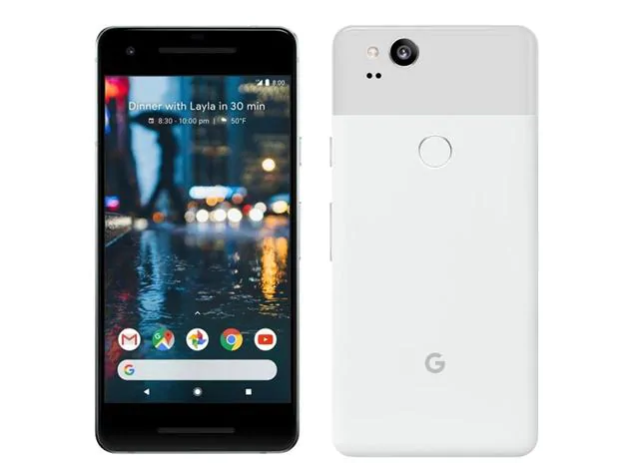
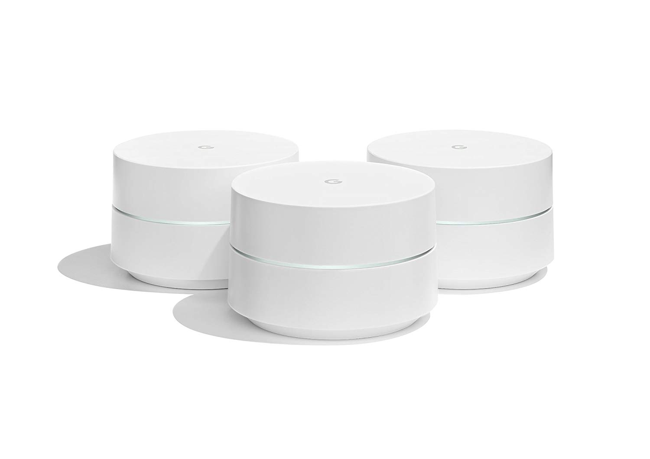
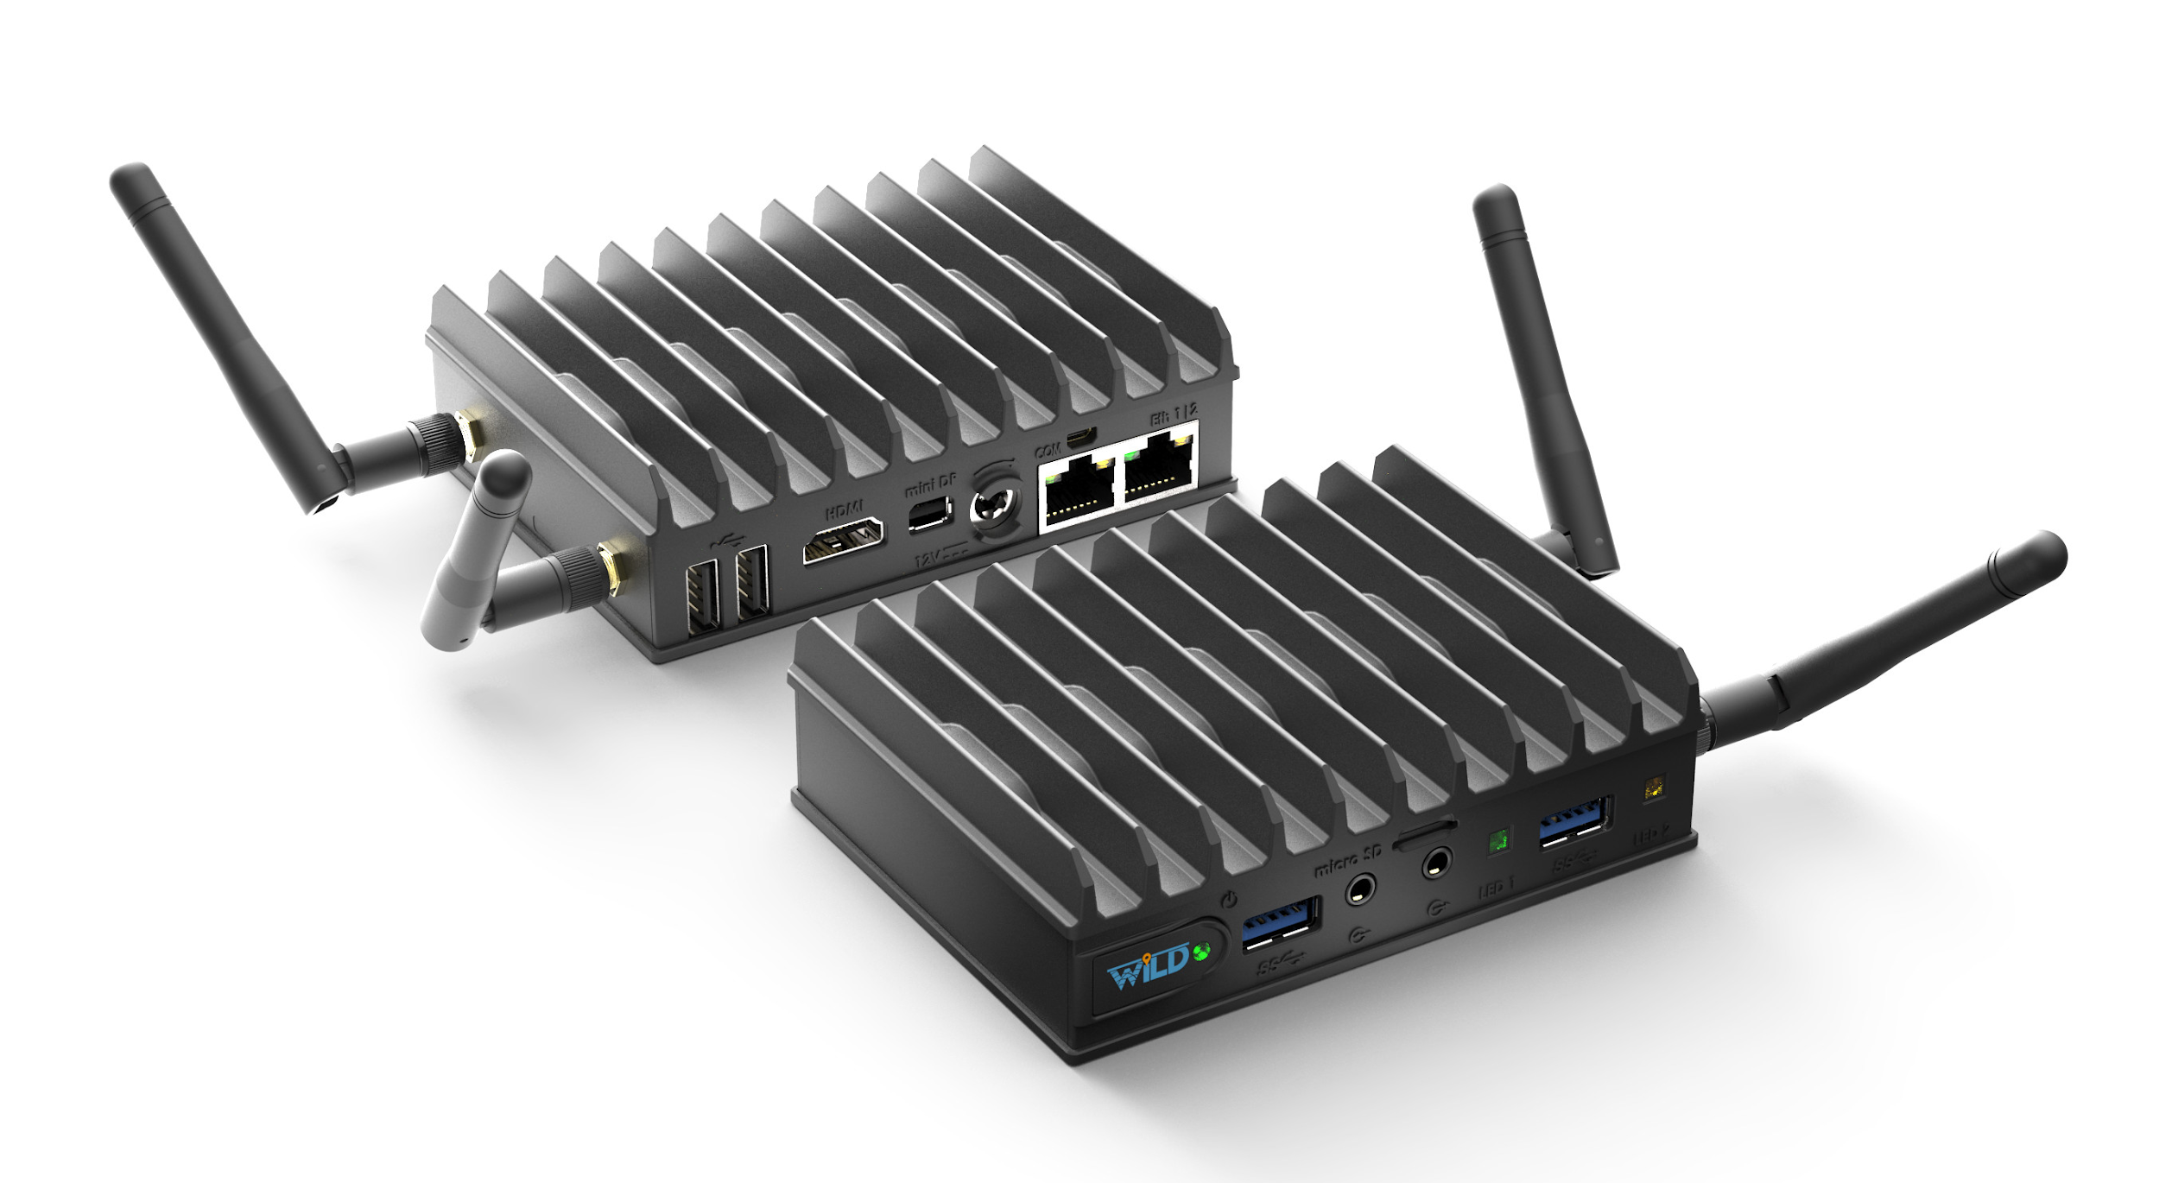
Hardwares
Device:
Pixel 2 running Android P
SoC: Qualcomm Snapdragon 835
AP:
Google WiFi with latest firmware update
SoC: Qualcomm IPQ4019 Wave 2
AP:
WILD AP
Wireless Chip: Intel 8260AC
CPU: Intel Celeron J3455
https://www.wi-fi.org/news-events/newsroom/wi-fi-certified-location-brings-wi-fi-indoor-positioning-capabilities
Notes:
Images Retrieved from https://drop.ndtv.com/TECH/product_database/images/104201774316PM_635_google_pixel_2.jpeg, https://www.google.com/url?sa=i&source=images&cd=&cad=rja&uact=8&ved=2ahUKEwjemPO0zLrgAhXqwVQKHX7pDuoQjRx6BAgBEAU&url=https%3A%2F%2Fwww.amazon.com%2FGoogle-WiFi-system-3-Pack-replacement%2Fdp%2FB01MAW2294&psig=AOvVaw0bkdGBrVcTOFE71SyjG39n&ust=1550212139821726, https://www.google.com/url?sa=i&source=images&cd=&cad=rja&uact=8&ved=2ahUKEwicy8rUzLrgAhWPAnwKHZPlCvQQjRx6BAgBEAU&url=https%3A%2F%2Fwww.cnx-software.com%2F2018%2F09%2F05%2Fcompulab-wild-wifi-rtt-router-802-11mc%2F&psig=AOvVaw2tHs4RhmySf_-BuB9hbpR6&ust=1550212212399946

Slide 9
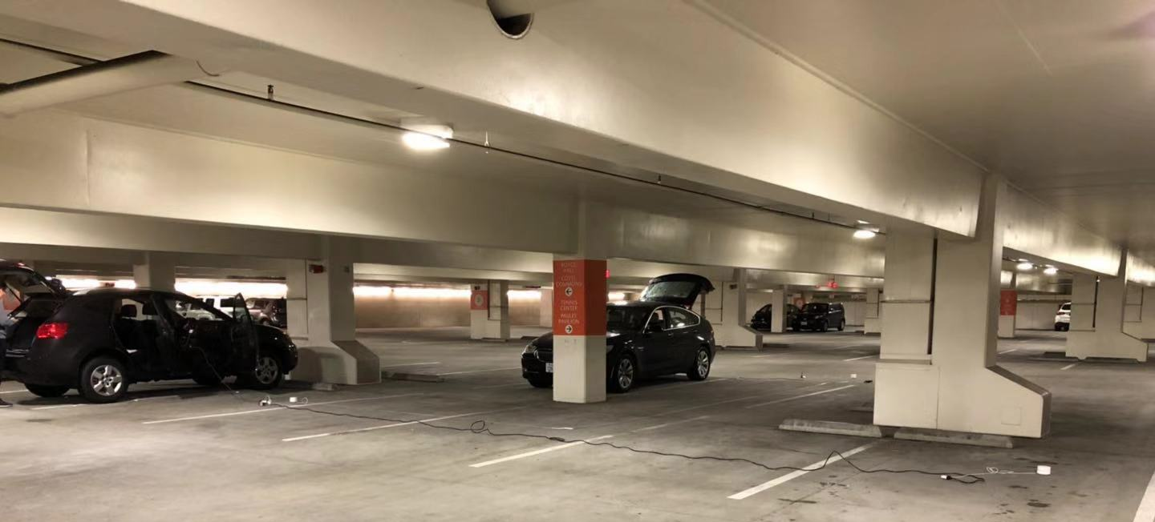
Setups
To power the APs: Car 12V supply -> 12V to 110V AC adapter -> Power Outlets/Extension Cord -> APs
Use tape measure to locate the APs and verify location

Slide 10
Tested Scenarios
Ranging: (tested for both Google and WILD)
Temperature: Outdoor @ noon vs. Outdoor @ night
Occupancy: Indoor w/ low occupancy vs. Indoor w/ high occupancy
Obstacles: In-room condition, tested in apartment
8 Antenna Orientation: tested in outdoor low occupancy condition
Concrete Obstacle: tested vertically in parking structure
Localization:
Tested in indoor, low occupancy, for both WILD and Google

Slide 11
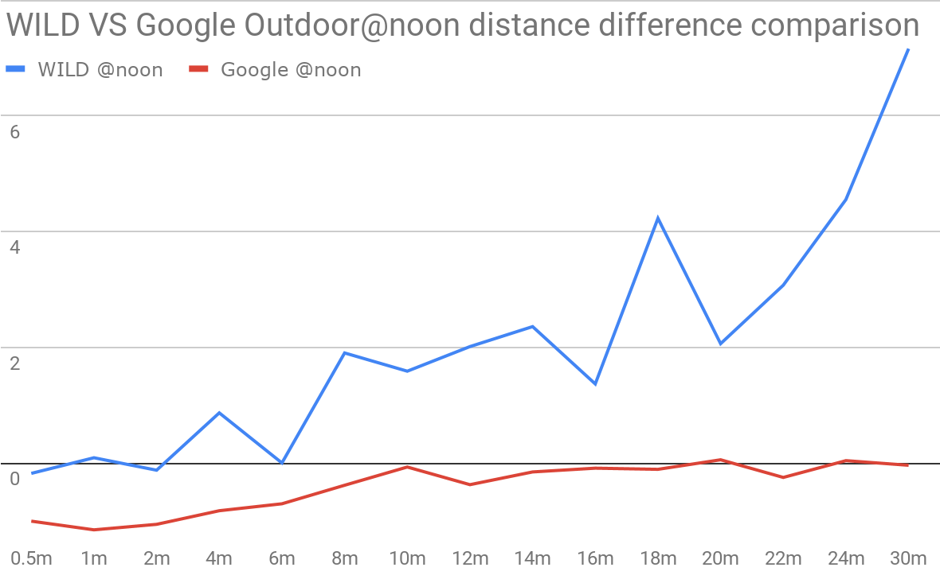
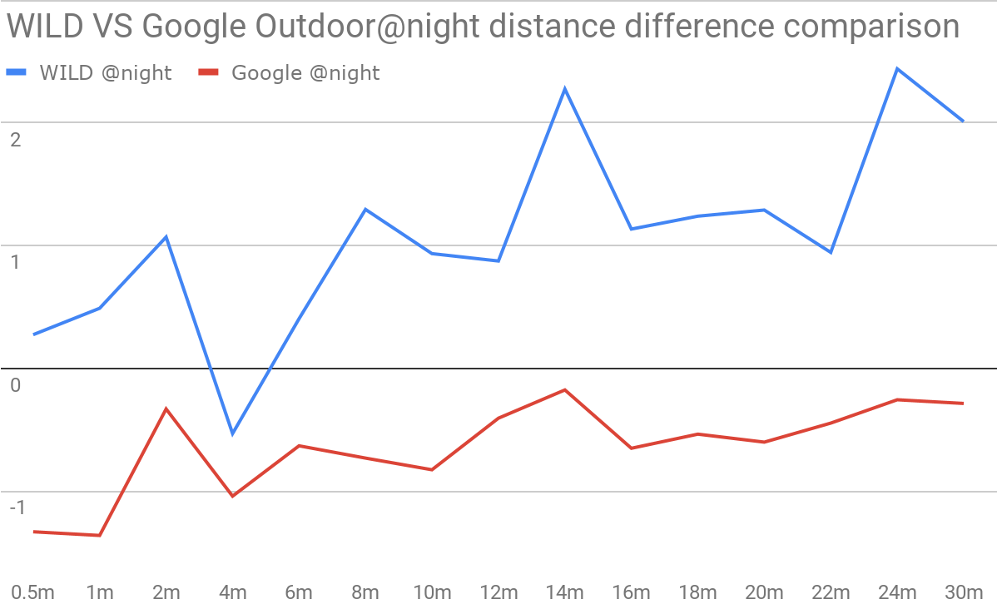
Data Analysis - Temperature
Noon: 17.5℃ (63.5℉）Night:9℃ (48.2℉)
Notes:
Talk about how the data is collected and calculated
Google converge to 0 line and it has smaller distance diff

Slide 12
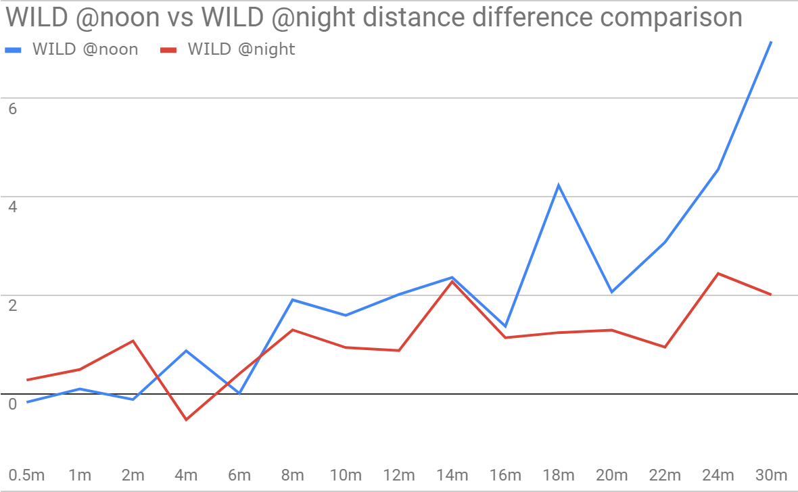
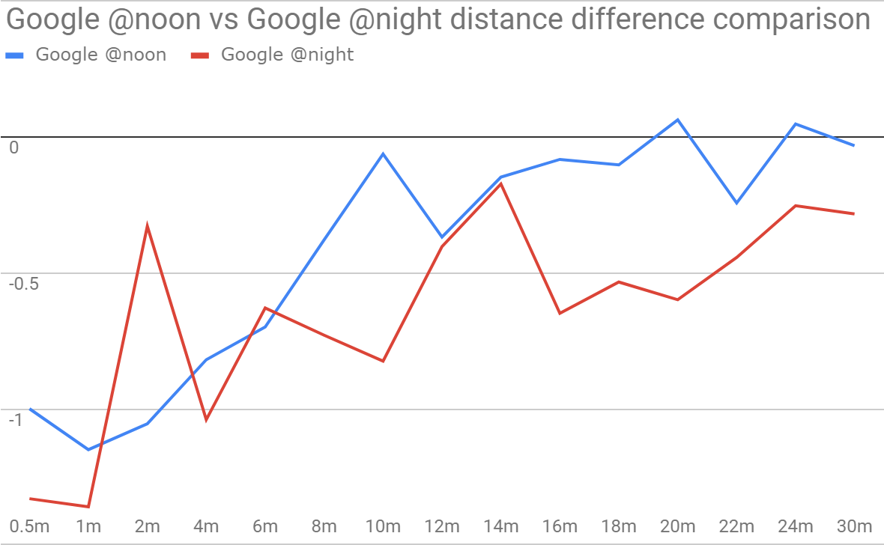
Data Analysis - Temperature
Notes:
WILD at night better than noon, but Google shows noon is better than night. Still google has smaller distance diff

Slide 13
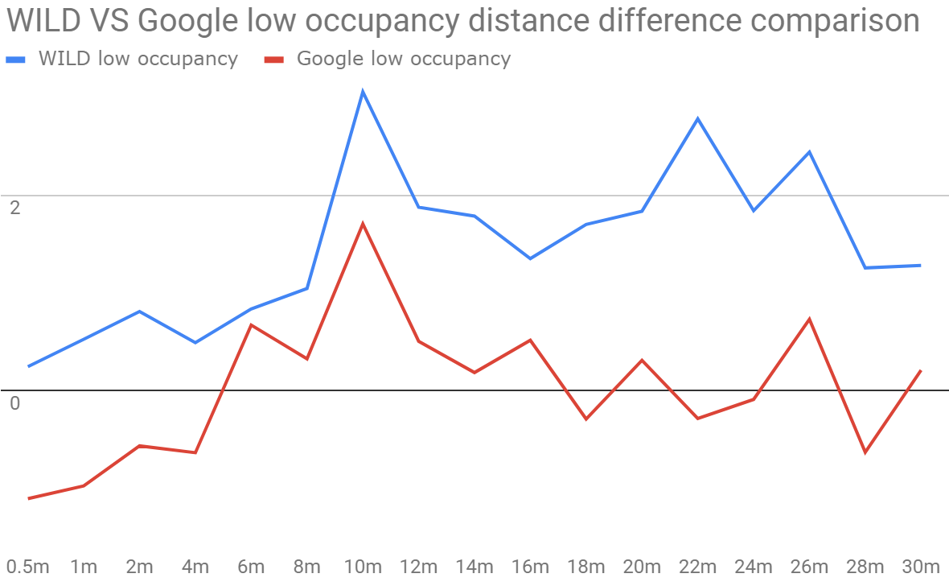
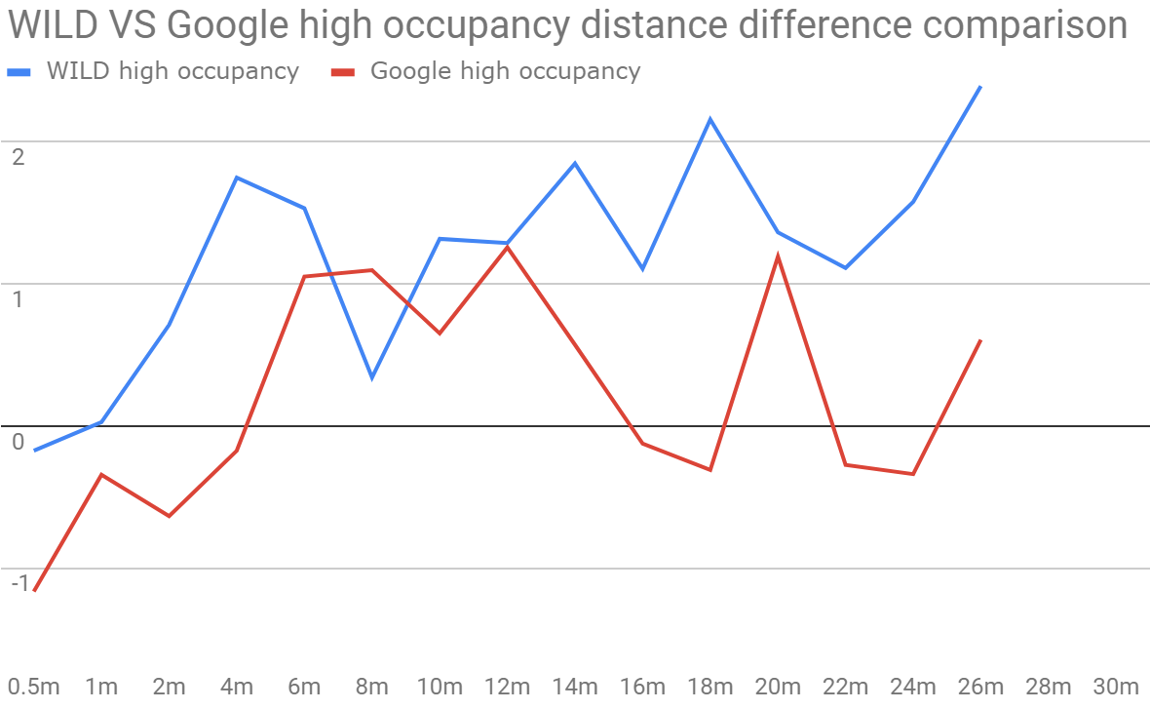
Data Analysis - Occupancy
Notes:
Google better than WILD in low and high occupancy

Slide 14
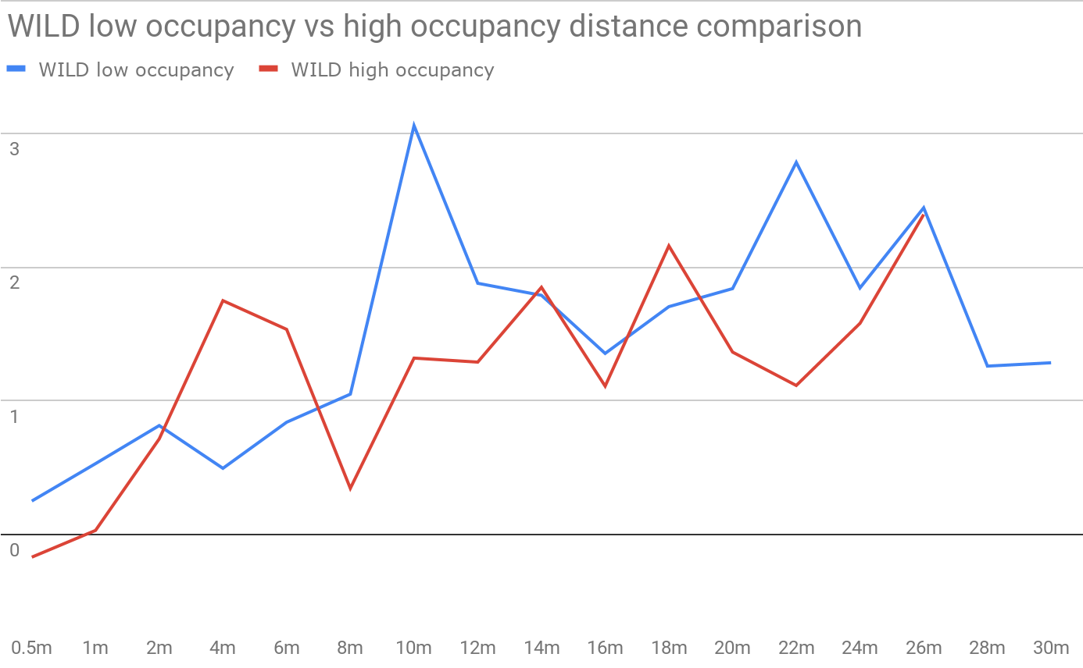
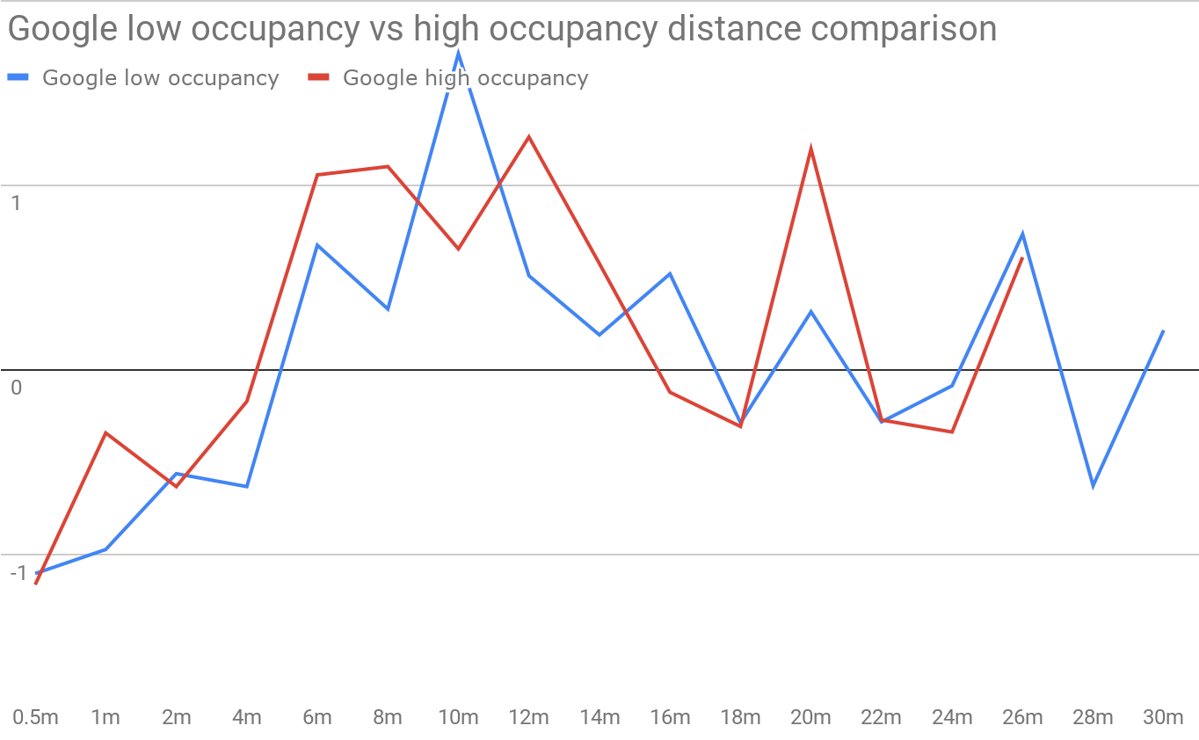
Data Analysis - Occupancy
Notes:
Similar distance difference but high occupancy makes the range of distance diff reduces. (No 28, 30)

Slide 15
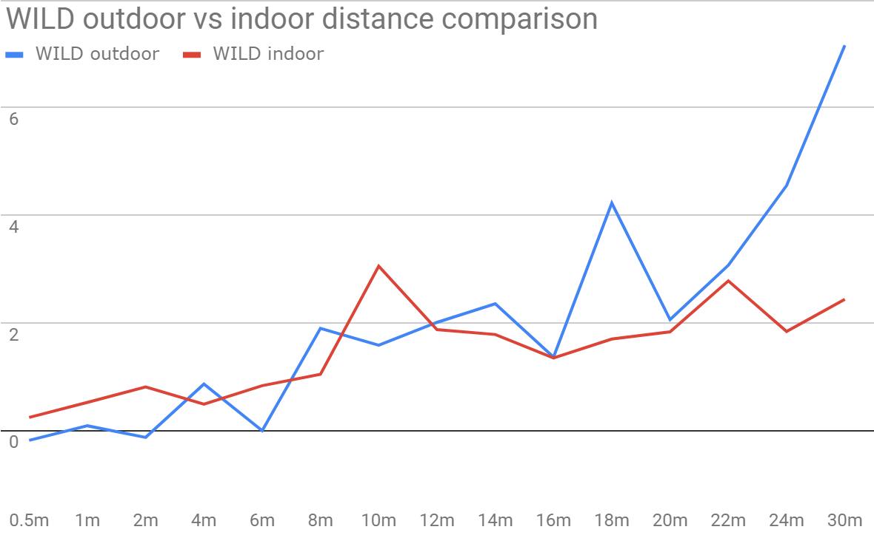
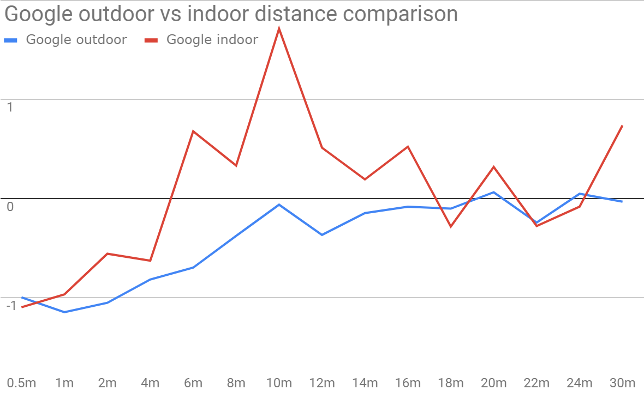
Data Analysis - Outdoor/Indoor
Notes:
WILD outdoor and indoor performs similar but Google outdoor slightly better than indoor

Slide 16
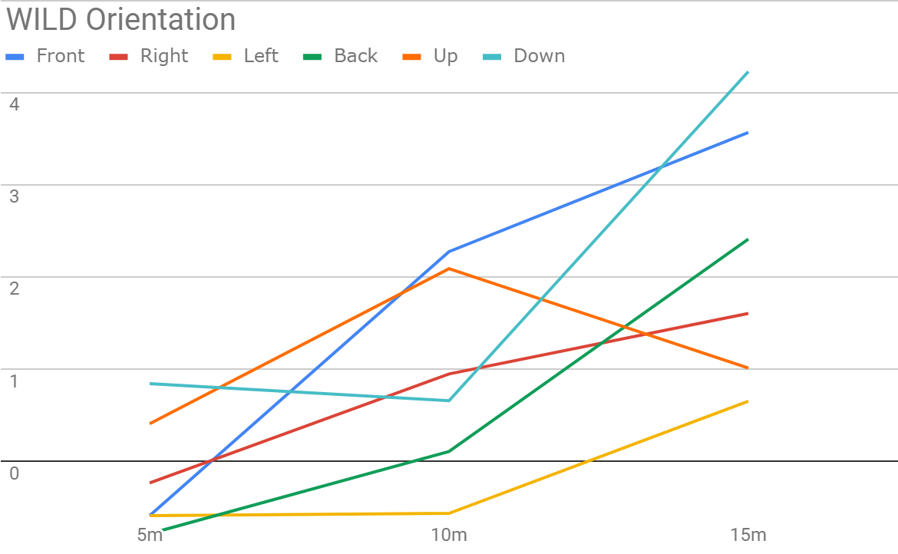
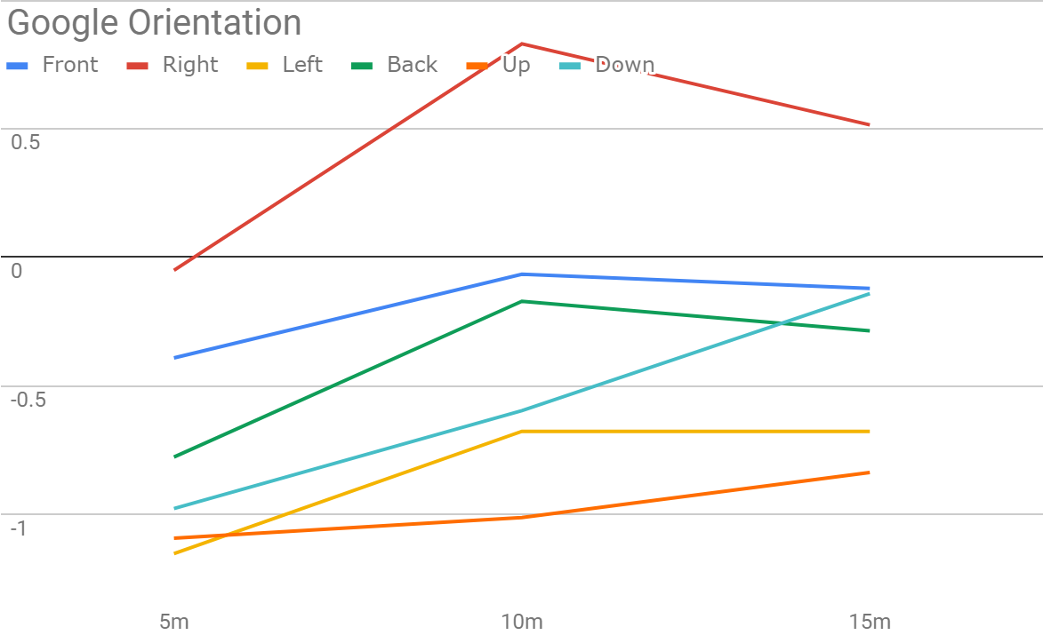
Data Analysis - Antenna Orientation
Notes:
Google better than WILD has lower distance diff

Slide 17
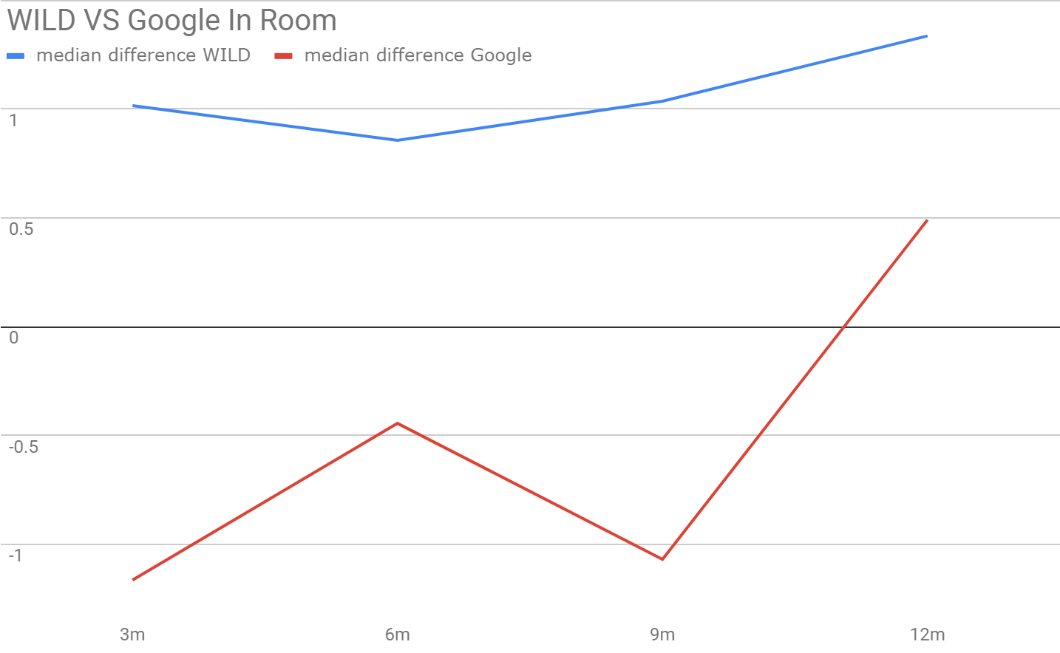
Data Analysis - In-Room
Notes:
Pretty similar. Point out that at low distance, Google seems to have offset that makes the distance lower than 0. WILD doesnt have negative distance record. We suspect this is the reason that Google is better than WILD is longer distances but worse than WILD in shorter distance

Slide 18
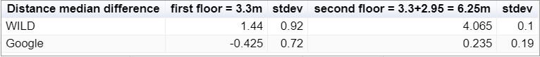
Data Analysis - Concrete Obstacles
Notes:
Google is better than WILD

Slide 19
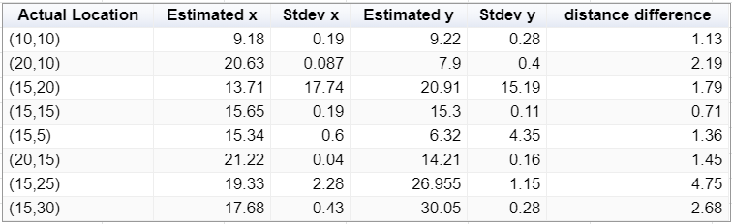
Data Analysis - Google Localization
Average distance difference: 1.85
Notes:
One distance diff that is much greater than the others.

Slide 20
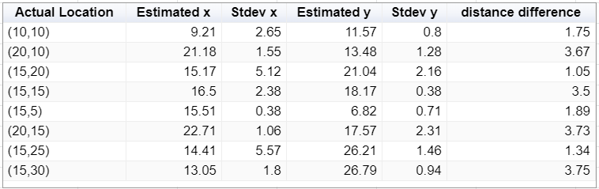
Data Analysis - WILD Localization
Average distance difference: 2.585
Notes:
Overall greater than Google

Slide 21
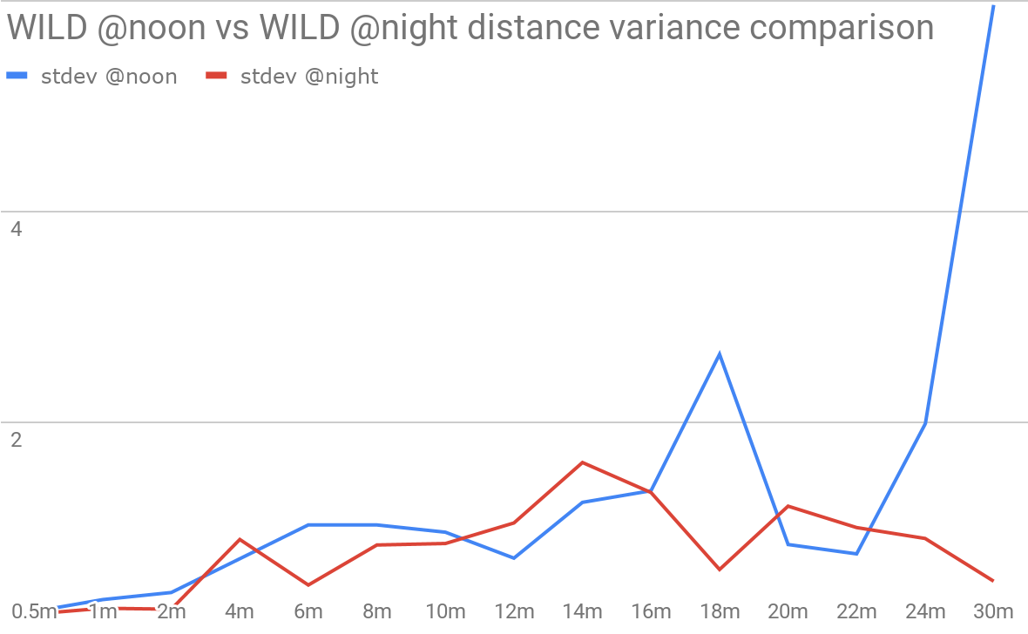
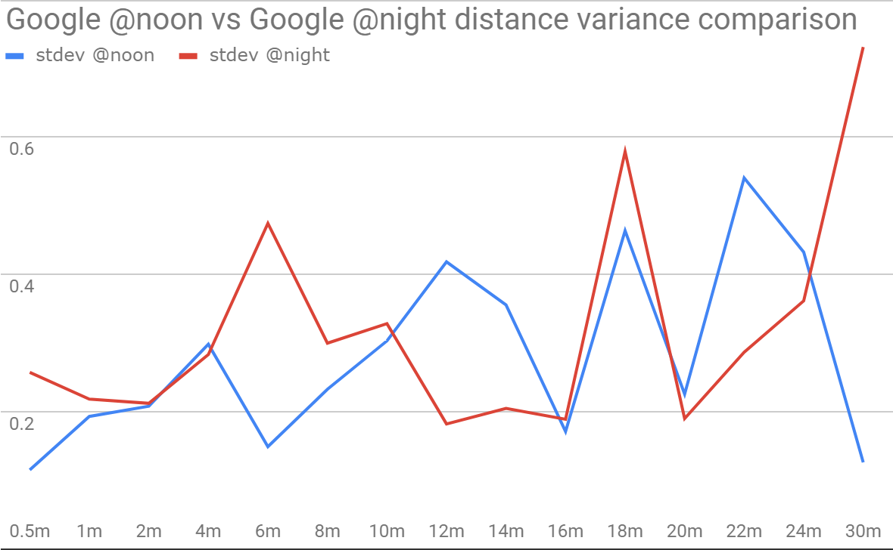
Data Analysis - Distance stdev
Notes:
Standard deviation WILD @night is lower than @noon. Google is better than WILD due to y axis

Slide 22
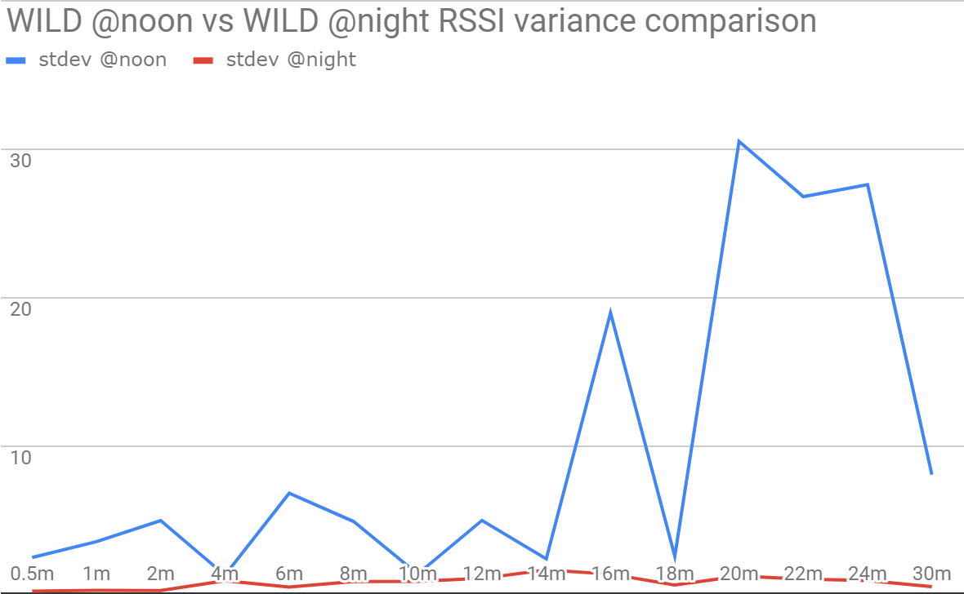
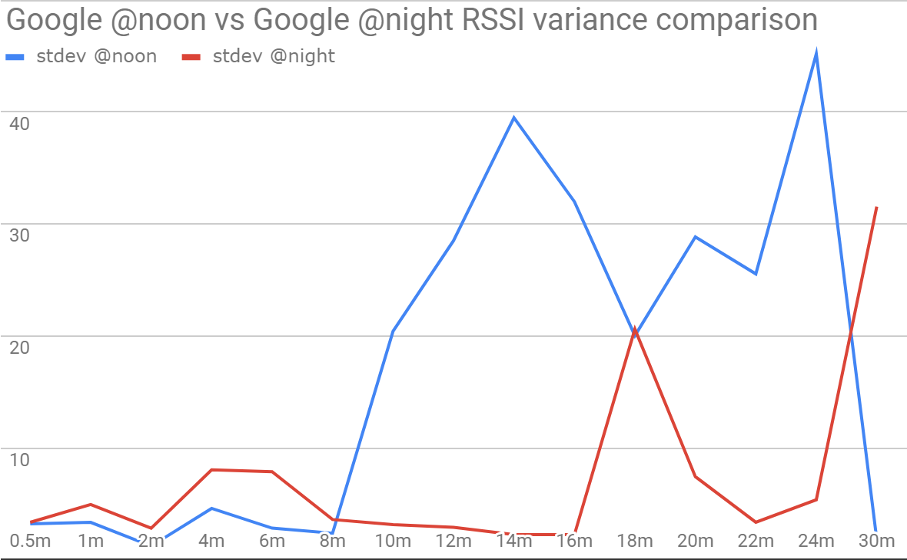
Data Analysis - RSSI stdev
Notes:
Google has higher fluctuation than WILD but better distance result. This means that it is not dependent on RSSI.

Slide 23
Application - Findurcar
Motivations:
In a large scale parking lot, it is difficult to memorize the location of parked car and people are having trouble finding their cars.
GPS signals won’t work when the parking structure is closed rooftop.
Relative Accurate localization method needed to provide this service.
Current solutions (such as Westfield, Santa Monica Parking Structure used cameras over all the parking spots) require lots of modifications to the parking structure and still failed to give directions based on user position.
Our App Features:
Requires minimal changes to the parking lots
Gives real-time directions as user walks
High Accuracy

Slide 24
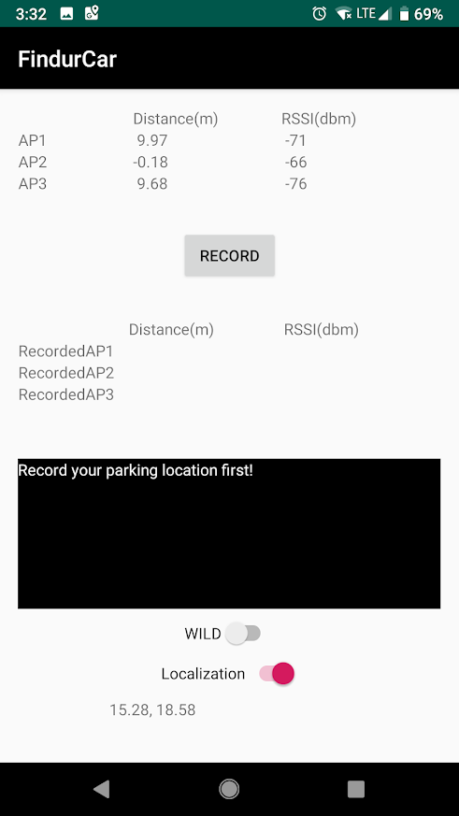
Our PoC Application
Display Current Location
Update Car Location
Basics:
Findurcar can display and record locations of your car when all three Google APs are presented
Findurcar will display the direction to find your car based on your orientation (Sensor.TYPE_ROTATION_VECTOR used)
Directions will include the distance and orientation of your car
Display Car Location
Main Display for Directions
Turn on if WILD is used as APs
Display Current Location

Slide 25
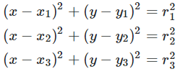
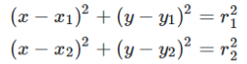
Localization Algorithm
3 Google APs @ (10,10), (15,20), (20,10):
2 WILD APs @ (0,10), (0,20):
Notes:
https://math.stackexchange.com/questions/884807/find-x-location-using-3-known-x-y-location-using-trilateration

Slide 26
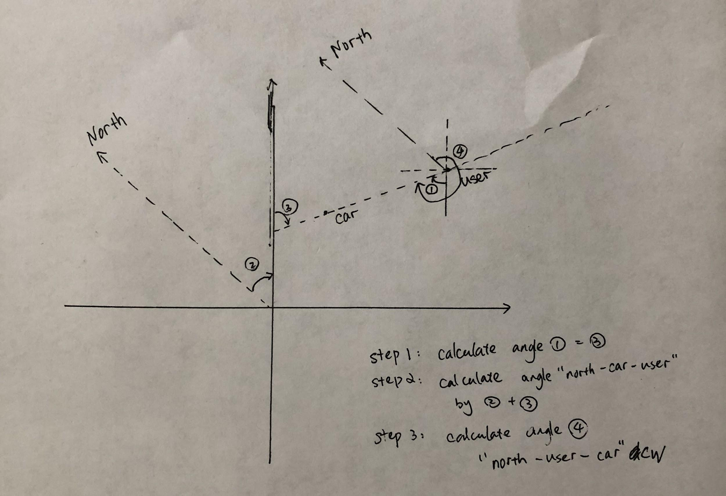
Orientation Algorithm

Slide 27
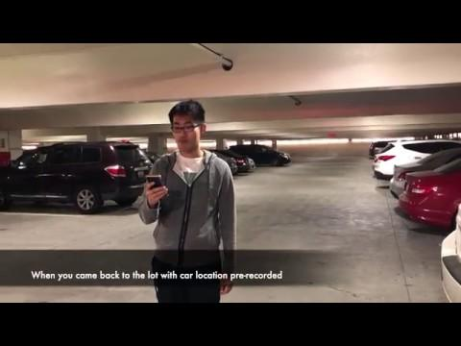
Show Time!

Slide 28
Future Work
Theoretical:
Improve localization precision by introducing sensor fusion
Develop different algorithms to optimize the precision
Collect more data with more accurate environment setup
Findurcar App:
Improve UI
Add user-friendly functions like auto-recording
Fuse the direction in a map view for given parking lot

Slide 29
Q&A

